Slide 1

Salary Prediction using Linear Regression
Building a Smart Programme to Guess Salaries
Priyanshu Anand
BCS 3B
Techno India University Kolkata

Slide 2
Our Goal: Teaching Machines to Understand Salaries
The Challenge
What We Built
Can we build a programme that learns from historical data to accurately predict employee salaries? The answer transforms how companies approach compensation.
A Python-based machine learning model
Training data from salaries.csv
Automated prediction pipeline
Traditional methods rely on intuition and subjective judgement. Our approach uses data science to make evidence-based decisions.
Fair, data-driven salary recommendations
The result? Companies can make offers based on facts, not feelings.

Slide 3





Understanding Our Dataset
Numerical Features
Categorical Features
Years of experience
Job title
Test score
Education level
Interview score
Location
Company size
Industry sector
Target Variable
The salary we aim to predict based on all input features combined.

Slide 4
Our Python Toolbox
Every great project needs the right tools. We selected four powerful libraries that work together seamlessly.
NumPy
Pandas
The numerical computing foundation. NumPy handles complex mathematical operations and array manipulations efficiently, making it perfect for processing large datasets.
Our data manipulation powerhouse. Think of Pandas as a super-intelligent spreadsheet that reads, cleans, and transforms our salaries.csv file effortlessly.
Scikit-learn
Matplotlib
The machine learning brain. This comprehensive library provides pre-built algorithms and tools for training, testing, and deploying our prediction model.
Our visualisation toolkit. Matplotlib transforms raw numbers into compelling graphs that reveal patterns and validate our model's performance.

Slide 5

The Challenge: Messy Data
Problem 1: Text Data
Computers are powerful calculators, but they don't understand words. Job titles like 'Junior Developer' or 'Senior Manager' are meaningless to algorithms that only process numbers.
We needed a way to translate text into numerical values.
Problem 2: Different Scales
Our features existed on wildly different scales. Years of experience ranged from 1-10, whilst test scores spanned 1-100. This imbalance causes models to incorrectly prioritise larger numbers.
Fair comparison requires standardisation.

Slide 6
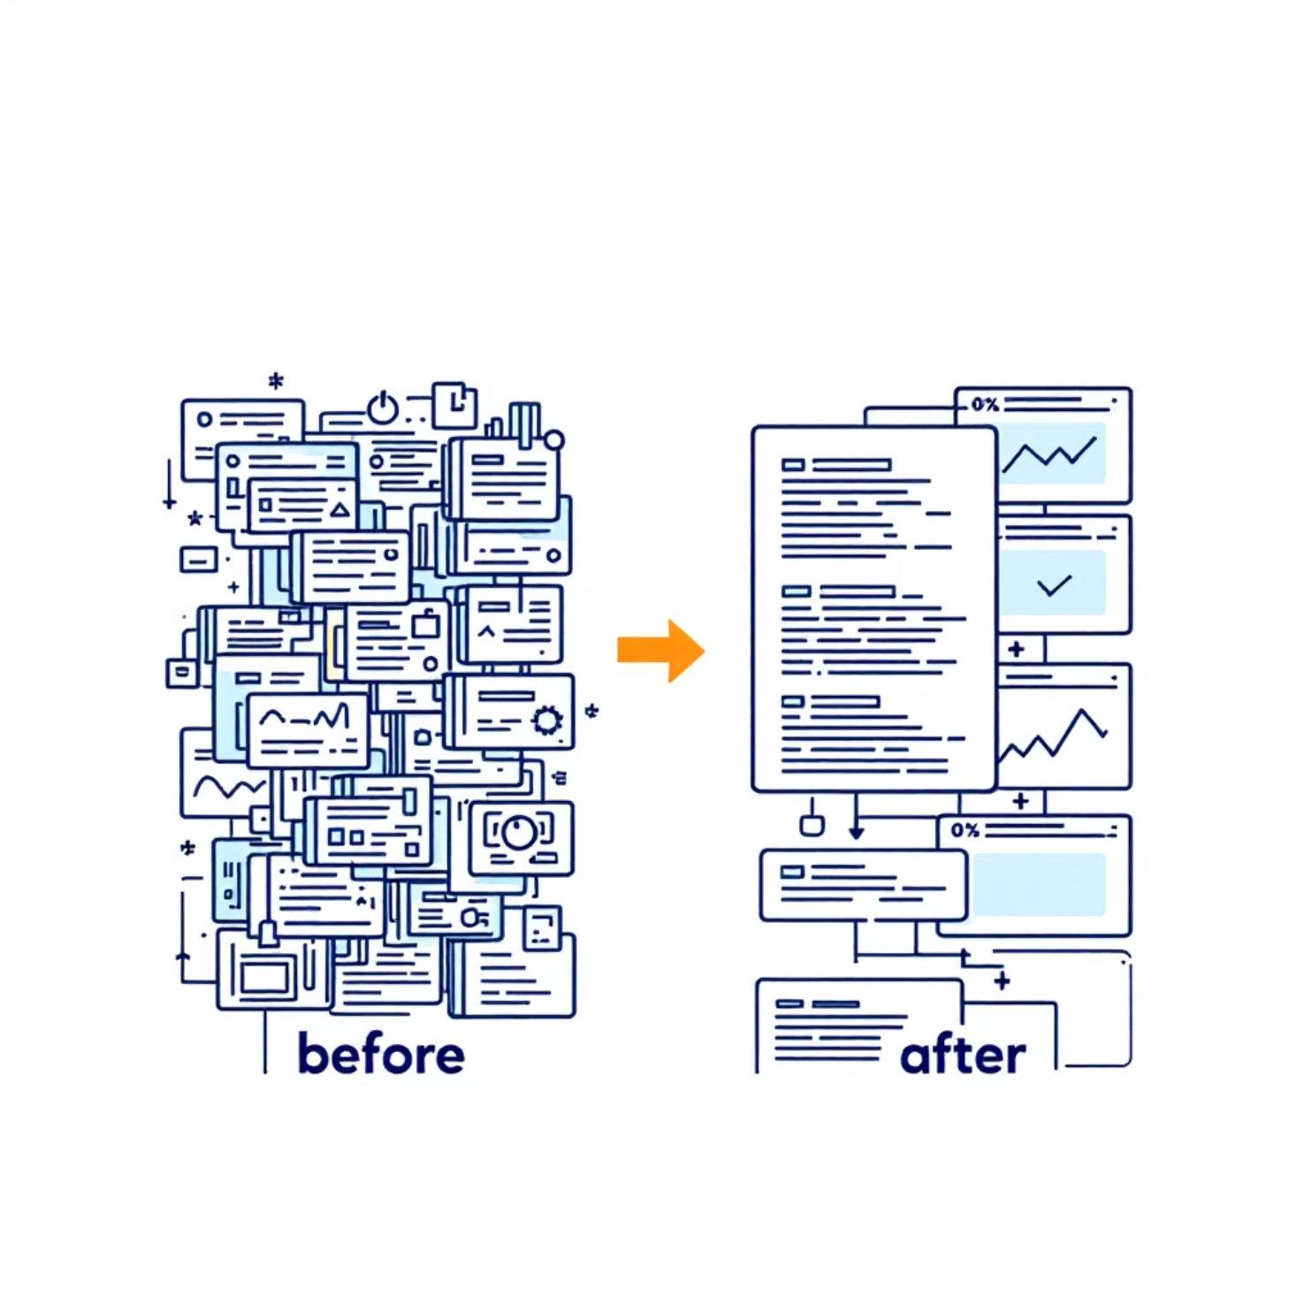
Data Preprocessing: Making It Computer-Friendly
01
OneHotEncoder for Text
Converts categorical text into binary (0s and 1s) format. Each unique category becomes its own column, enabling the model to process qualitative information.
02
StandardScaler for Numbers
Transforms all numerical features to have the same scale, typically with mean = 0 and standard deviation = 1. This ensures fair treatment across all variables.
These scikit-learn transformers work automatically, requiring minimal code whilst delivering maximum impact.

Slide 7





The Pipeline: Our Smart Assembly Line
This is where our project becomes truly elegant. A Pipeline chains multiple data processing steps into one streamlined operation.
Raw Data Input
Unprocessed information from our CSV file
Automatic Cleaning
Encoding and scaling happen seamlessly
Model Training
The algorithm learns patterns
Predictions
Accurate salary estimates
This approach keeps our code tidy, reduces errors, and makes the entire process reproducible with a single command.

Slide 8

Results: An Outstanding Performance
We tested our trained model on data it had never seen before. The results exceeded expectations.
98.3%
Low
R² Score
Mean Absolute Error
Our model explains 98.3% of salary variation. This exceptional score indicates the programme captured nearly all meaningful patterns in the data. An A+ performance.
The average difference between predicted and actual salaries was remarkably small. Our programme's guesses were consistently close to real values.
What does this mean? Our model is production-ready. With 98.3% accuracy, it can confidently support real-world salary decisions in corporate environments.

Slide 9
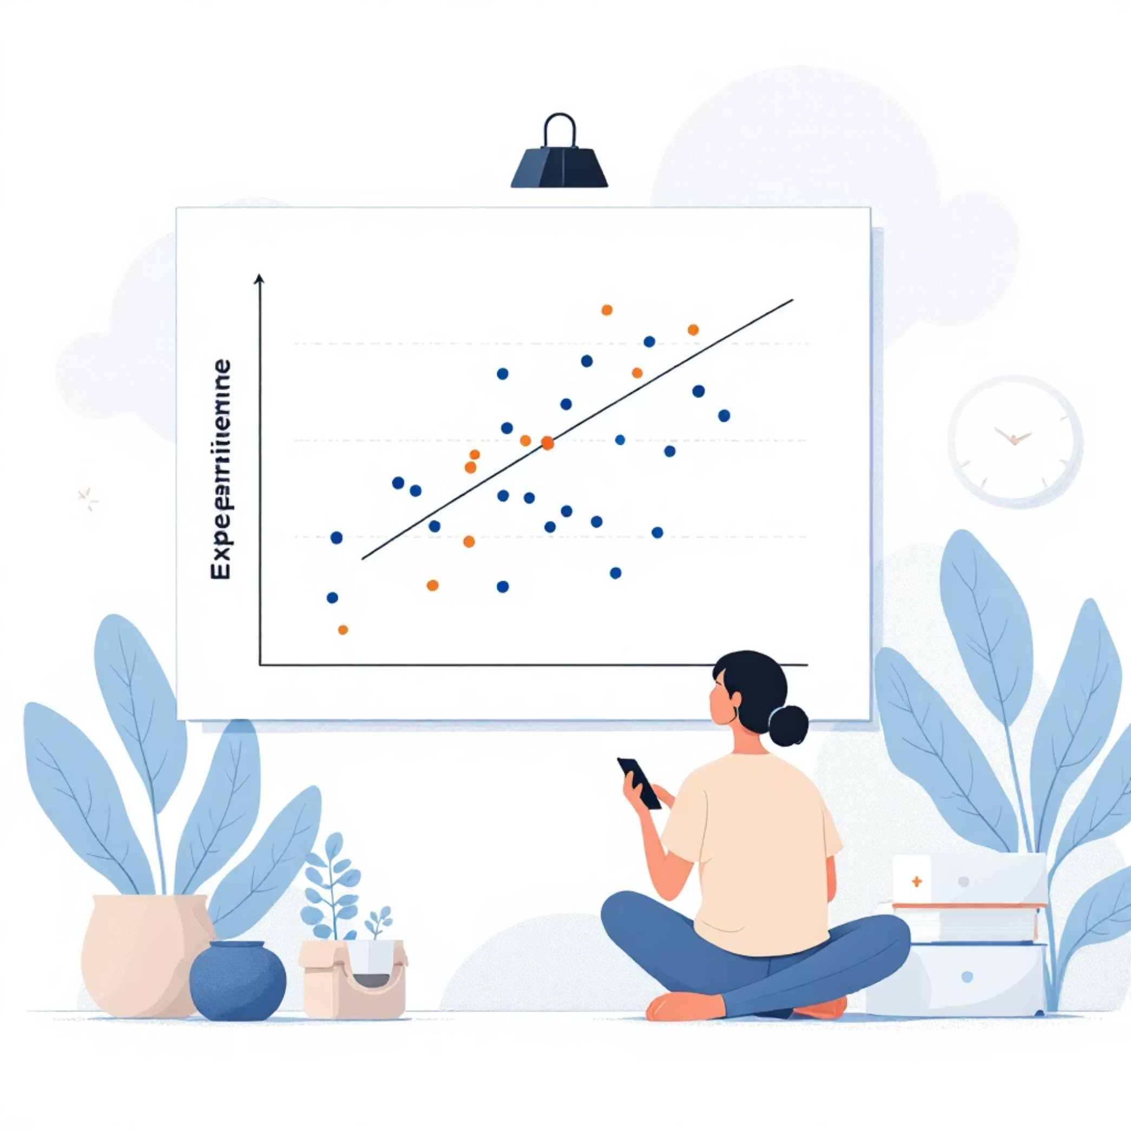
Visualising the Patterns
What the Graph Reveals
Using Matplotlib, we plotted years of experience against test scores. A clear correlation emerges: employees with more experience tend to achieve higher test scores.
This visualisation validates our data quality and confirms that our features have meaningful predictive power.
Graphs aren't just pretty pictures—they're essential tools for building trust in our model.

Slide 10
What We Accomplished
🎯 Complete ML Pipeline
📊 Exceptional Accuracy
💾 Reusable Model
An automated system that handles preprocessing, training, and prediction without manual intervention.
98.3% R² score demonstrates our model's reliability for production deployment.
The trained pipeline is saved as a file, ready to generate predictions on new data anytime.
We've demonstrated how Python, scikit-learn, and proper data science methodology combine to solve real-world business problems. This project transforms how organisations approach compensation planning.
Thank You!
Questions? Let's discuss how machine learning can revolutionise decision-making in your organisation.

